Slide 1

Farmers Desk - A Farmer Companion
Problem Statement Id : AGRI14
Problem Statement Title: App To Monitor Soil Moisture Using A Standard Digital Image And Machine Learning Technology.
Team Name: Complex Diggers
Team Id: UIA117
Theme Name: Life, Agricultural Development

Slide 2

Team Members and Mentor
Team Members: Participant Id:
Anish Modi (Team Leader) IND-1-219
Mitashi Bansal IND-1-107
Emmanuel Kwame Ayanful GHN-2-00016
Jaya Shukla IND-1-184
Jonathan David Nyoni ZIM-45-00003
Nosi Chefane LSO-44-00014
Team Mentor: Mentor Id:
Mr. Shubham Shukla IND-
Mr. Ajay Rana IND-

Slide 3
Problem Statement Code:UIA117
App To Monitor Soil Moisture Using A Standard Digital Image And Machine Learning Technology.

Slide 4
Motivation
Aim: Current methods for sensing soil moisture are problematic -- buried sensors are susceptible to salts in the substrate and require specialised hardware for connections, while thermal imaging cameras are expensive and can be compromised by climatic conditions such as sunlight intensity, fog, and clouds.
App should determine moisture content based on a standard image/ video by analysing the differences in soil colour to determine moisture content.
An artificial neural network (ANN) /machine learning software can be trained to recognise different soil moisture levels under different sky conditions. This monitoring system could potentially be trained to recognise the specific soil conditions of any location, allowing it to be customised for each user and updated for changing climatic circumstances, ensuing maximum accuracy.
This app may be a promising tool for improved irrigation technologies in agriculture in terms of cost, availability and accuracy under changing climatic conditions.
Fig 1: Educated v/s Uneducated
Fig 2: Users prefer Sensors v/s Application

Slide 5
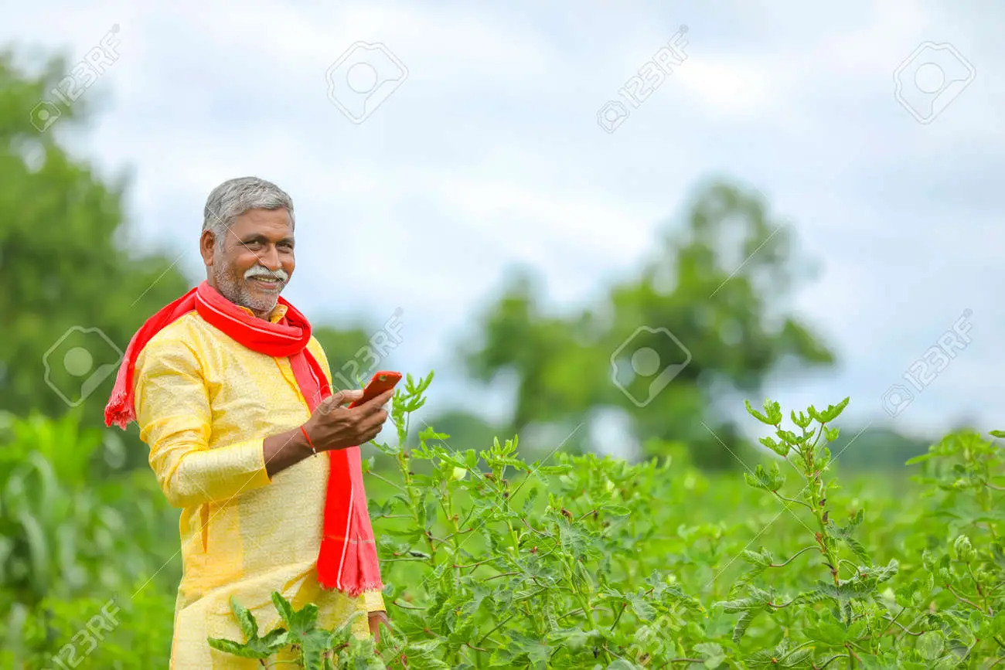

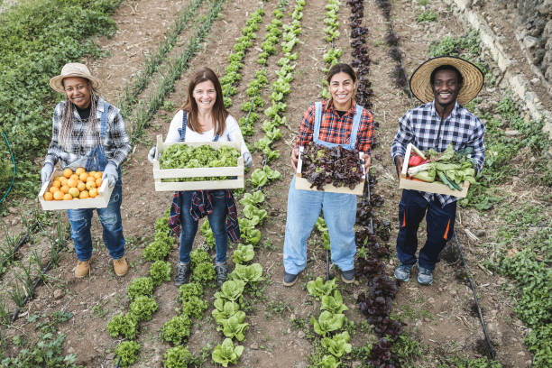
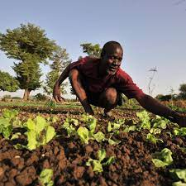
Novelty & Uniqueness
User Friendly
Portability
Language Support
Offline Mode
Security
Copyright: Westend61 / Jose Luis CARRASCOSA
https://support.google.com/legal/anwer/3463239?hl=en

Slide 6








Tech Stack
Flutter
Sensors
Java
Mobile Net
Python
Datasets of Soil Images
Node JS
ANN ML models
Google Collab
VS Code

Slide 7
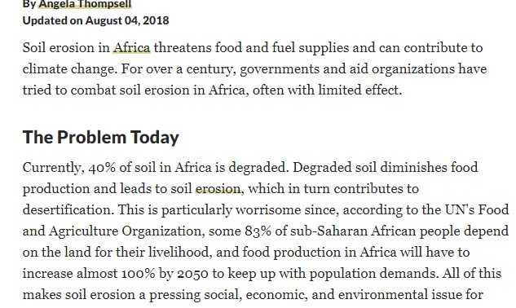
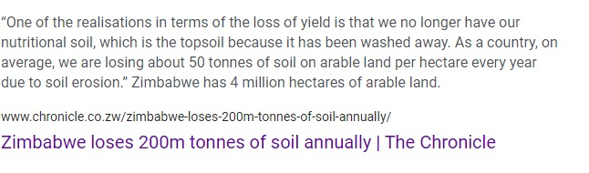
Business Perspective
Gain profit from private company
Excess and Scarcity of water content in soil
Decrease in yield loss

Slide 8
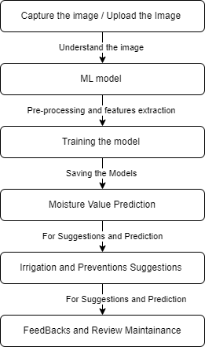
Methodology Adopted

Slide 9
MODEL’S REACTION TO USER QUERY
After detecting the Image and comprehending it.
The system attempts to find the most appropriate response to that remark about the soil moisture.
After obtaining the machine's response. The system goes one step further.
After detection it will display the soil moisture in the Application .

Slide 10
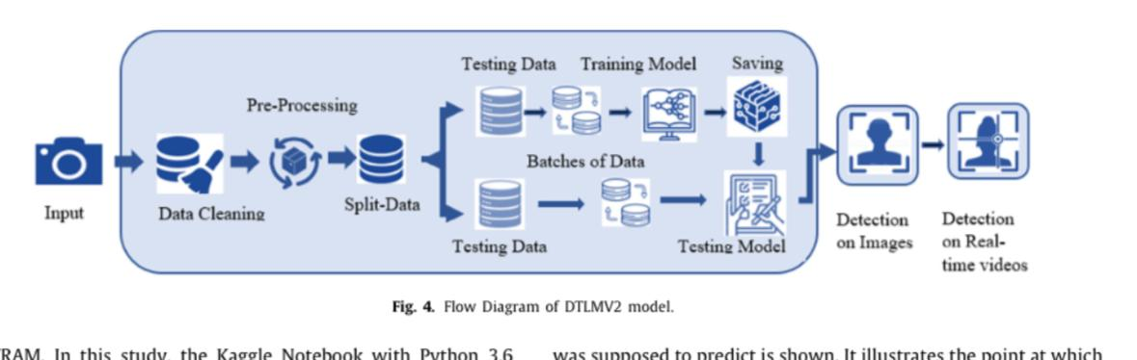


Approach used:
Testing Data
Training Model
Saving
Pre-Processing
Batches of Data
Input
Data Cleaning
Split-Data
Detection on
Images
App will Display
Soil Moisture
Testing Data
Testing Model

Slide 11


